Slide 1
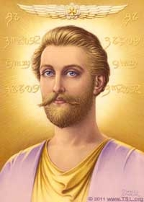
Notes:
Some of the slides have animation on them. ALL the animation has been formatted to happen automatically without needing to press ENTER for it.

Slide 2
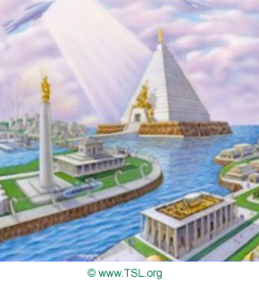
Notes:
Saint Germain lived as the high priest of the violet temple. He was schooled in at Archangel Zadkiel’s retreat, which stood where the island of Cuba now stands. This fact is like a clue. You will hear it later as the story continues.
But the continent of Atlantis was about to sink due to people turning away from God. The Great Divine Director entrusted Saint Germain and a few other faithful priests with a most important task. (GO TO SLIDE THREE)

Slide 3
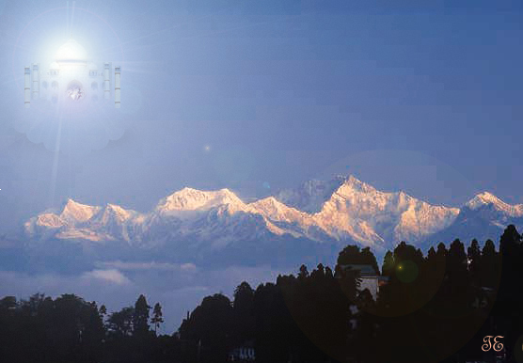
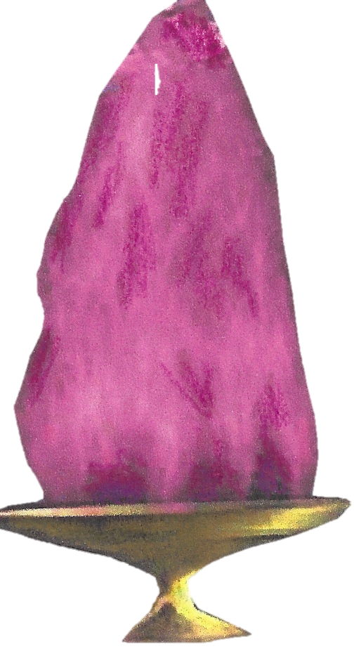
Notes:
They were to transport the flame of freedom to a place of safety in Transylvania. What do you think? Could this be another link? (Pause.)
Now, let’s jump ahead all the way to the 1200’s, when Saint Germain was embodied as Roger Bacon. (GO TO SLIDE FOUR)

Slide 4
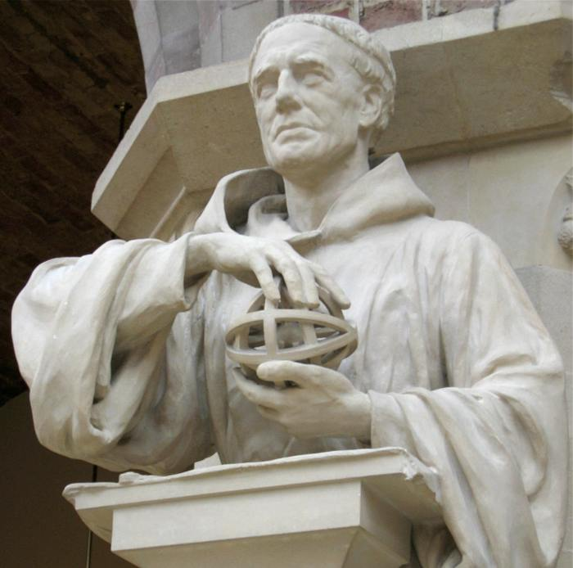
Notes:
Bacon predicted that “the sea between the end of Spain on the west and the beginning of India on the east is navigable in a very few days if the wind is favorable.” This statement was not completely correct. Do you know why? (Allow children to answer.) Yes, the land discovered would not be India, but the New World. Yet, the statement was important because it played a role later in Columbus’ discovery. What part did it play? Aaah, you’ll find out along the way.
Now, we skip two hundred years ahead to 1492, to Saint Germain’s embodiment as Christopher Columbus. (GO TO SLIDE FIVE)

Slide 5
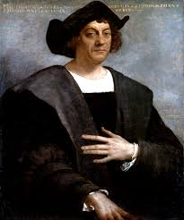
Notes:
Columbus loved the ocean. It was a time that explorers were sailing the seas and Columbus began to think about a voyage of his own. He wanted to carry the message of the Christ to the new world. That message, as we know it today, is that the Christ lives in each of our hearts as the freedom flame. What is this freedom flame’s other name? (Pause.) Yes, the threefold flame! (GO TO SLIDE SIX)

Slide 6
Notes:
Columbus wrote a letter to King Ferdinand and Queen Isabella of Spain requesting their sponsorship for his voyage. In the letter he used the quote from his previous incarnation of Roger Bacon, “the sea between the end of Spain on the west and the beginning of India on the east….” Of course, we know the king and queen agreed to sponsor his mission.
For weeks and weeks Columbus and his crew sailed the ocean. Then on one special day, October 12, one of the men pointed and said, “Look, land ahead.”
But this was not just any land. Do you know where it was? (Allow children to answer.) Not in North America as many think and not in the Far East. The flame of freedom at Lord Zadkiel’s retreat in Cuba magnetized Columbus to this island, once part of Atlantis. So, on that famous day, he landed right back where he started as the high priest. (GO TO SLIDE SEVEN)

Slide 7
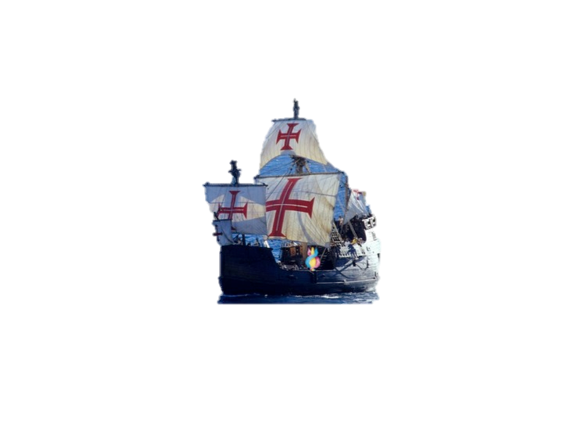
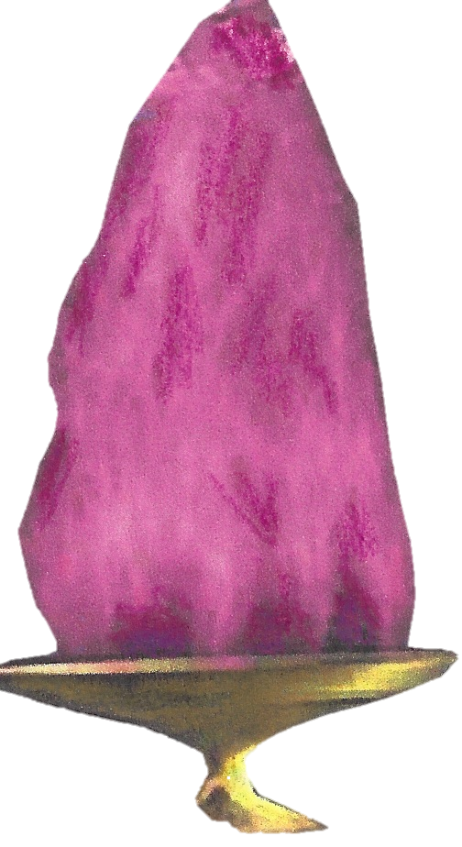
Notes:
Let’s fast forward to the 1600’s, the time of Saint Germain’s embodiment as Francis Bacon. (GO TO SLIDE EIGHT)

Slide 8
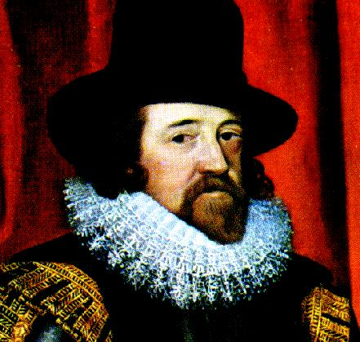
Notes:
At the end of this life on May 1, 1684, the soul of Saint Germain entered the ritual of the ascension from the Rakoczy Mansion in Transylvania, the retreat of the Great Divine Director. Was this place mentioned previously in our story? (Pause.) Yes, it’s where the flame of freedom had been transported from Atlantis, blazing in all its glory.
Even though Saint Germain made his ascension, he was not finished with establishing freedom on earth. He requested a dispensation from the Lords of Karma to return to earth, however, not to be born, but to “appear” in a physical body. The Karmic Board granted his request.
He was called the Wonderman of Europe. Mystery surrounded him. (GO TO SLIDE NINE)

Slide 9
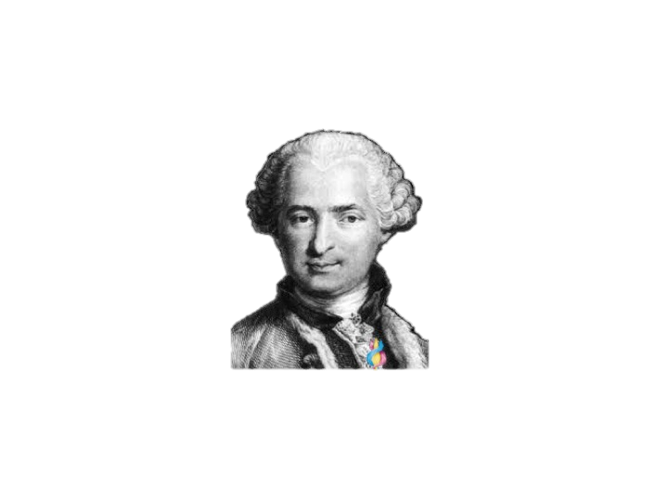
Notes:
He appeared here, he appeared there, he seemed to appear everywhere. One thing is certain – he was highly visible in the royal courts—AND invisible!
He visited kings and queens. He would disappear and reappear unpredictably all over Europe. He spoke at least twelve languages so fluently that everywhere he went he was accepted as a native. “Bonjour,” he’d say in France and “Buon giorno,” in Italy.
Who was this mystery man? He was le Comte de Saint Germain. (GO TO SLIDE TEN)

Slide 10
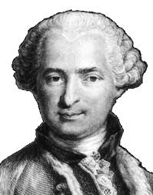
Notes:
It is said that the Comte de Saint Germain appeared here and there for over a hundred years old. He wanted to unite Europe but the leaders there did not respond to him. So he turned his attention toward the United States.
In 1776 in America, the writers of the Declaration of Independence were debating whether or not to sign this document. For to sign it meant that England would declare these men as traitors and their lives would be at risk. At a key moment, a “mystery” man appeared and shouted, “Sign that document!” (GO TO SLIDE ELEVEN)

Slide 11
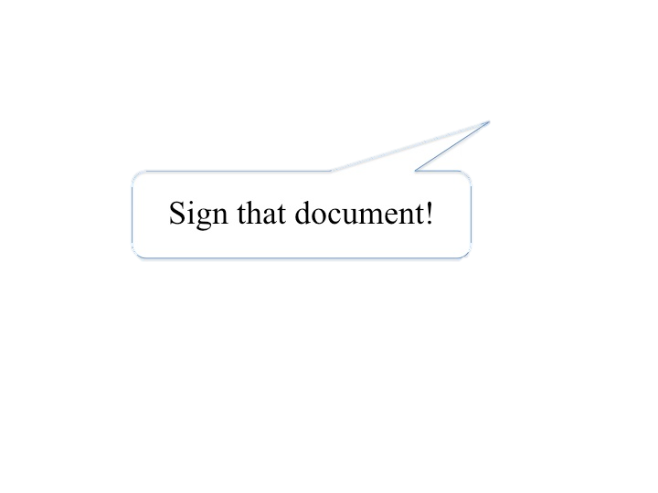
Notes:
They did and America went on to become a free nation.
By now you can probably guess this mystery man’s name. (Pause.) Yes, our beloved Saint Germain! (GO TO SLIDE TWELVE)

Slide 12
Notes:
Today we know that Saint Germain sponsored America to focus freedom for the nations of the world. America is not just a place; it is the focus for the entire I AM Race. We’re not quite finished with our mystery game. What gift of freedom do we have today from our beloved Saint Germain? (Pause.) Right the violet flame! (GO TO SLIDE THIRTEEN)
Let’s stand and show our gratitude to this remarkable ascended master who loves the flame of freedom. Let’s stand and say 3x, “Hail Saint Germain!”
We are now going to do a fun activity about these embodiments of Saint Germain.

Slide 13
Notes:
Let’s stand and show our gratitude to this remarkable ascended master who loves the flame of freedom. Let’s stand and say 3x, “Hail Saint Germain!”
We are now going to do a fun activity about these embodiments of Saint Germain.

