Slide 1
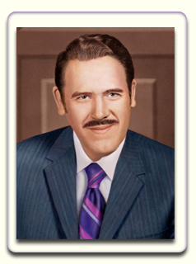
Notes:
Some of the slides have animation on them. ALL the animation has been formatted to happen automatically without needing to press ENTER for it.
Good morning. Welcome to you and all the families and children on the broadcast. This morning our story is about our beloved ascended master Lanello when he was embodied as Mark L. Prophet, his last embodiment.

Slide 2
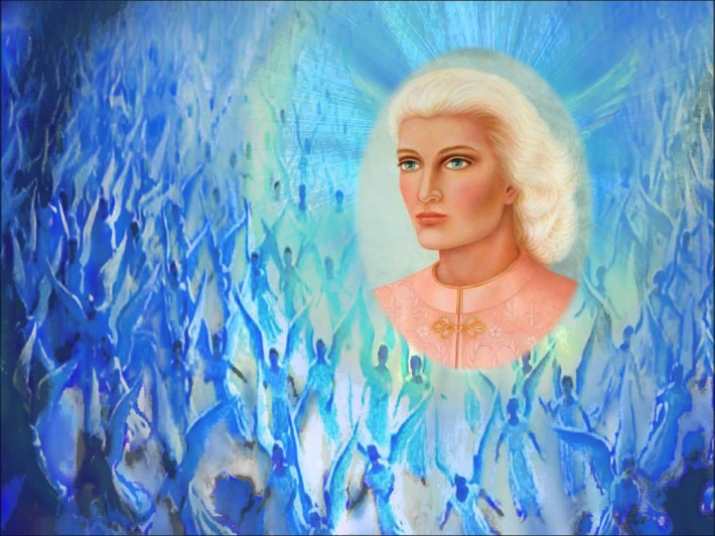
Notes:
Did you know that this soul came thousands of years ago to planet earth? (Pause.) When Sanat Kumara came from Venus to keep the flame of light on earth, Lanello and his twin flame, our beloved Guru Ma and other evolutions of light came with him. The story of Lanello’s mission throughout all his embodiments is one of a soul seized with a passion that is the love of God.

Slide 3
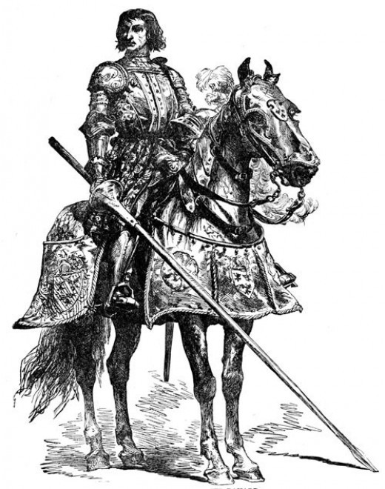
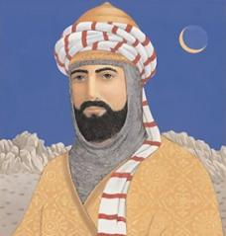
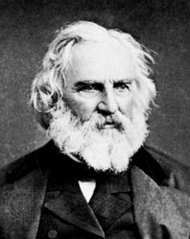
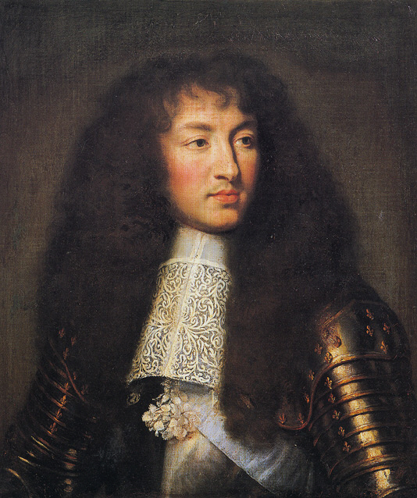
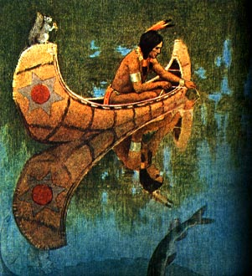
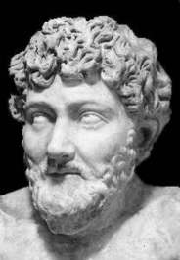
Notes:
Do you know what some of Lanello’s embodiments were? (Allow children to answer.) I will just mention a few of them. Have you heard of Sir Launcelot, a knight in King Arthur’s court or Saladin, the great Moslem leader in the 12th century, known for his generosity, gentleness, honesty and justice to all peoples? Aesop the creator of Aesop’s fables and what about the poet, Henry Wadsworth Longfellow? Lanello also lived as the Iroquois chief, Hiawatha. In his last embodiment as Mark Prophet, he started the Summit Lighthouse, our organization.

Slide 4
Notes:
Our story today is from this book, Memories of Mark – My Life with Mark Prophet, written by Annice Booth. Mrs. Booth said, “… he was so close to God that he was truly an adept.” Do you know what an adept is? (Allow children to answer.) An adept has the ability in controlling matter and physical forces. In other words, it appears as if the adept is performing miracles.
Our story today is about Mark’s ability in working with elementals, the nature spirits. Mrs. Booth is telling the story.

Slide 5
Notes:
“We disembarked from the ship in Bremerhaven, Germany in an absolute downpour. Mark had rented a Volkswagen van for us to tour Europe.
We were all crowded into this one rented van. We had to put all our luggage on the roof but were unable to find a tarp in the entire city. There was nothing to do but to start traveling and hope that the rain would not ruin our luggage.
Since we had no reservations for that night, it took quite a while to find an inn with vacancies enough for this many people. In the meantime, our luggage was getting drenched.

Slide 6
PEACE, BE STILL
Notes:
All of a sudden from the front seat, I heard the words, “Peace, be still.” I have never experienced such love in my entire life as was contained in just those three little words. The rain stopped instantly. No one seemed to have noticed Mark’s command to the elementals except me. Eventually someone in the car said, “Oh, look, it stopped raining!” No one seemed to have realized the impact of what Mark had accomplished in love.
Mrs. Booth shares another story about Mark and elementals.

Slide 7
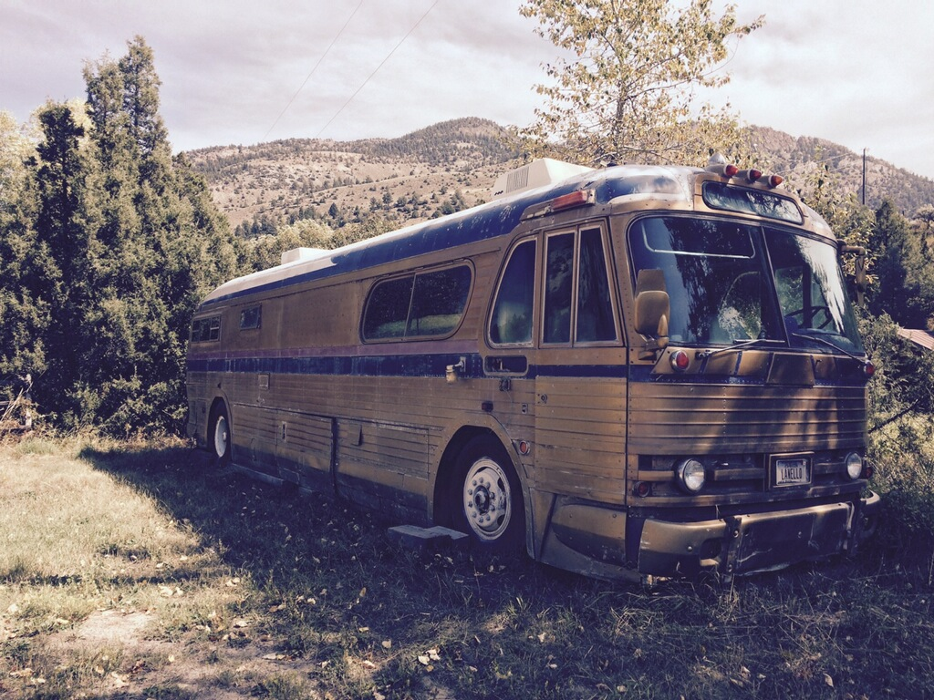
Notes:
There came a time when Mark was traveling so often to Santa Barbara and other spots for lectures and seminars that transportation became a problem. He found it more efficient (and fun, too) to refit an old Greyhound bus for a mobile home that would carry the family and several staff members on his trips. He took great pride in rebuilding this bus and painted it gold. We always referred to it thereafter as the “gold bus.”
Did you know that bus still exists today? If you and your parents drive up on the road toward the Heart of the Inner Retreat, you will see the bus on the left. You can stop and go inside and experience the very same bus that Mark used to drive.
The story continues. “It was the style at that time, if you owned a large mobile home, to tow a motorcycle along behind for convenience on trips inside cities. It was much easier to ride a motorcycle in city traffic than to maneuver this large bus and to try to find a parking place. And anyway, Mark had always wanted an excuse to ride a motorcycle.

Slide 8
Notes:
(There was) one little elemental that felt familiar enough with Mark that he could play a game with him. One sunny, summer afternoon at La Tourelle Mark decided to go for a motorcycle ride. All of a sudden Mark came dashing in the gate on his motorcycle screaming, “Hey, stop it, stop it!” This one little cloud was following him, raining right immediately over him, and there was no rain anywhere else in the sky.
It was the most amazing sight I have ever seen. Mark was absolutely soaked, and the rest of us were perfectly dry. (Mark) said, “This little guy wanted to play, and I just couldn’t get him to stop.”

Slide 9
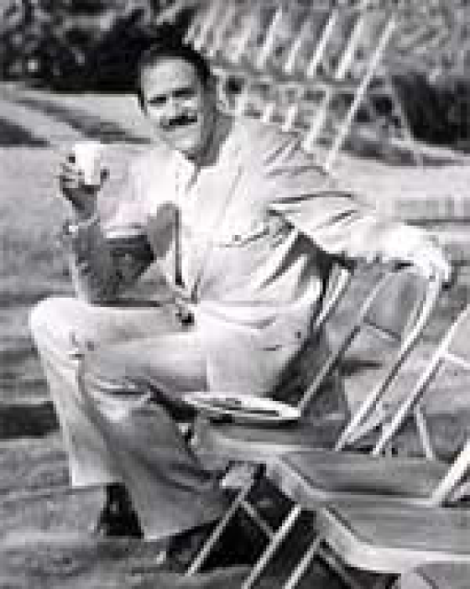
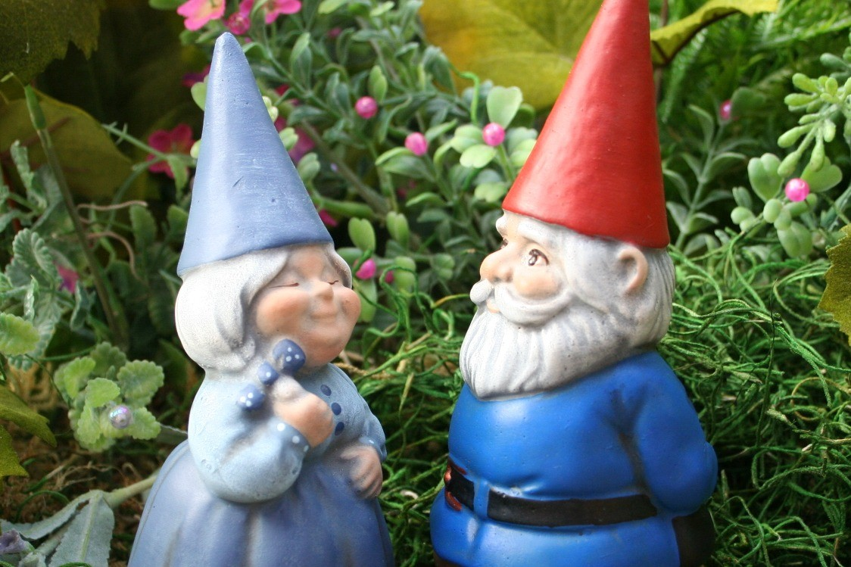
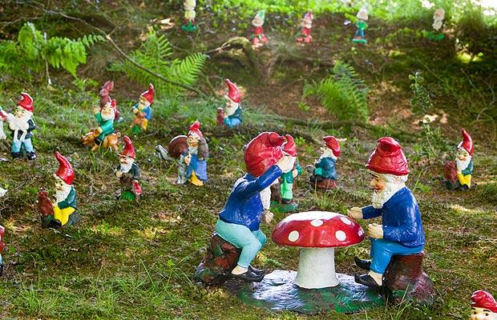
Notes:
“You could never guess what would happen next when you lived with Mark Prophet, who lived in two worlds at the same time. The elementals loved Mark and in turn responded to his love and served him.
(Mark) could turn the hail back up in the sky. He could stop rain. He could reverse the course of a hurricane and send it back to sea. He could turn a fire back into itself. He could cause the thunder to roll across the sky. I have personally witnessed many of these feats.”
CONCLUSION:
I hope these true stories helped you understand why Mark Prophet was called an adept. He truly performed what is considered miracles.

Slide 10
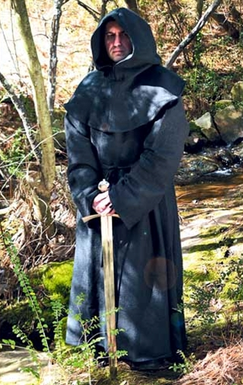
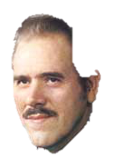
Notes:
In one dictation, the ascended master Lanello gave us a gift. He said, “Yes, I have fashioned a blue cape for each one of you; that is, my angels – they have taken the fashioning that I have given to them and styled a most noble garment complete with hood like the monks of old. … these angels are going to place my cape upon you that you might also go forth wearing the momentum of my victory in many past embodiments, which I have taken forth from my causal body as a momentum of light to give unto you….”
Lanello gave us a blue cape so that we could have the momentum of his victories in his past embodiments. Let’s imagine ourselves putting on this blue cape now. (Demonstrate putting on imaginary cape.)

Slide 11
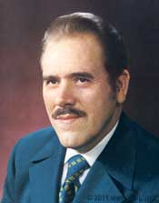
Notes:
Now, let’s stand and show our love for beloved Lanello for all that he has done and does for us each day. Let’ say, “Hail Lanello,” 3x.

